Slide 1



Sales Forecasting
View in Power BI
Last data refresh:
3/17/2024 10:16:48 PM UTC
Downloaded at:
3/17/2024 10:26:47 PM UTC

Slide 2
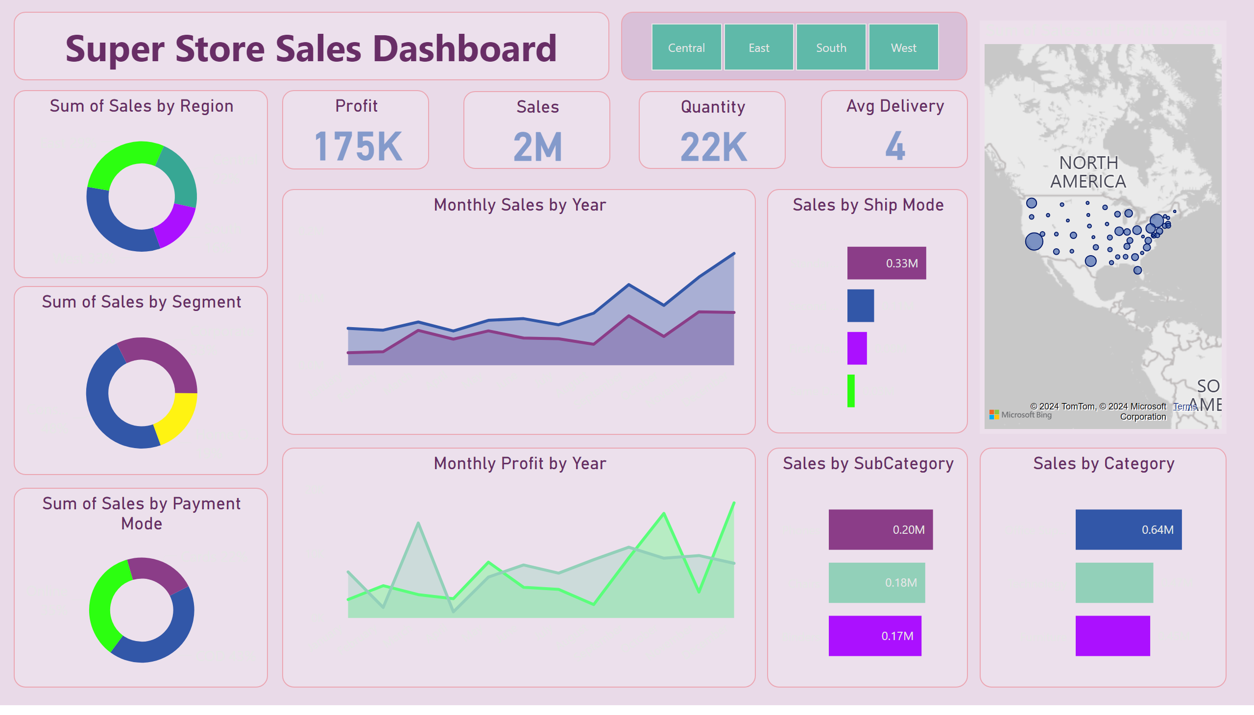
Main
Notes:
Sales by Category
No alt text provided
Sales by SubCategory
No alt text provided
Monthly Sales by Year
No alt text provided
Monthly Profit by Year
No alt text provided
Sum of Sales and Profit by State
No alt text provided
Sales by Ship Mode
No alt text provided
donutChart
No alt text provided
donutChart
No alt text provided
slicer
No alt text provided
textbox
No alt text provided
Profit
No alt text provided
Sales
No alt text provided
Quantity
No alt text provided
Avg Delivery
No alt text provided
donutChart
No alt text provided

Slide 3
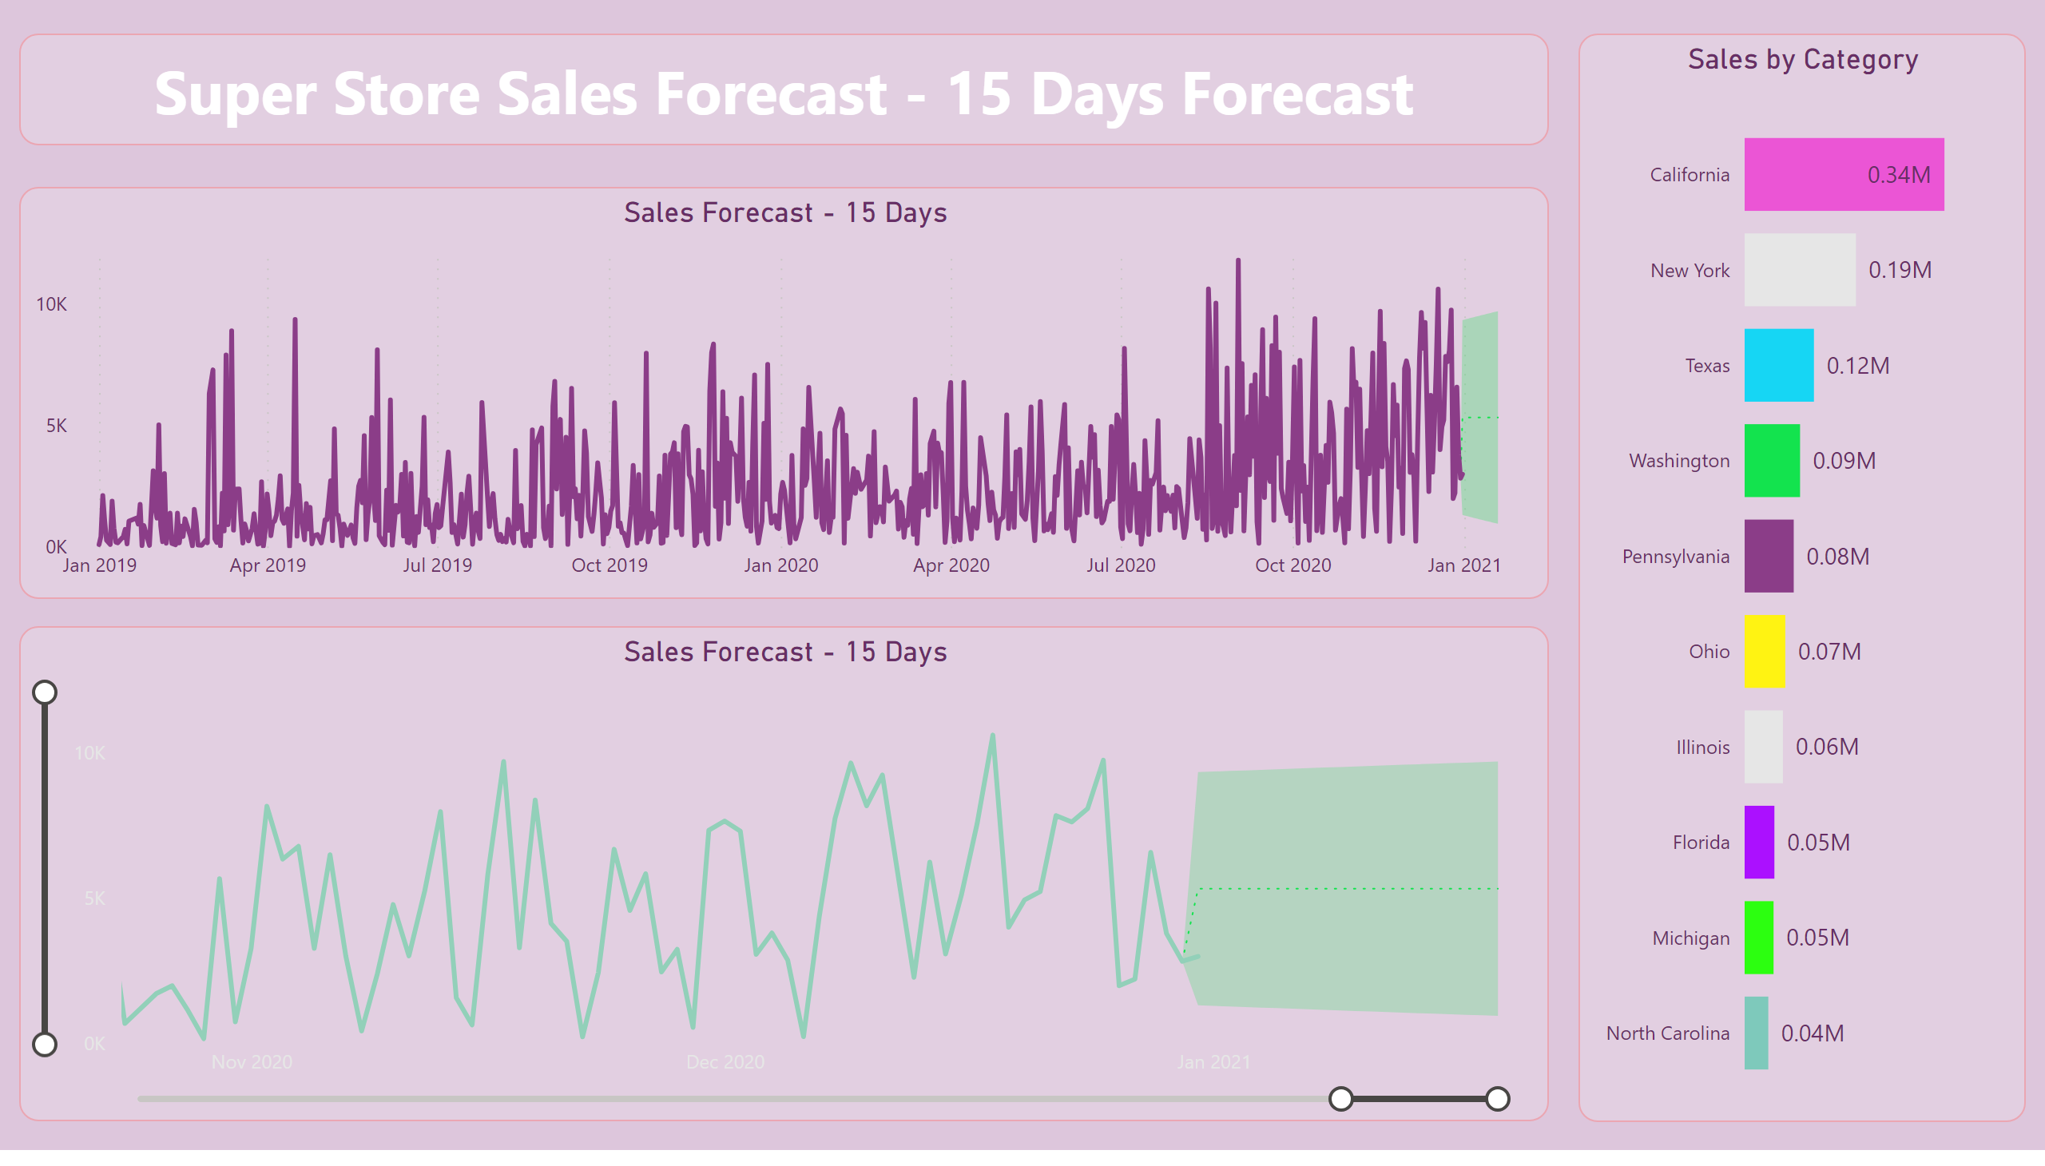
Forcasting
Notes:
Sales Forecast - 15 Days
No alt text provided
Sales Forecast - 15 Days
No alt text provided
Sales by Category
No alt text provided
textbox
No alt text provided

Slide 4
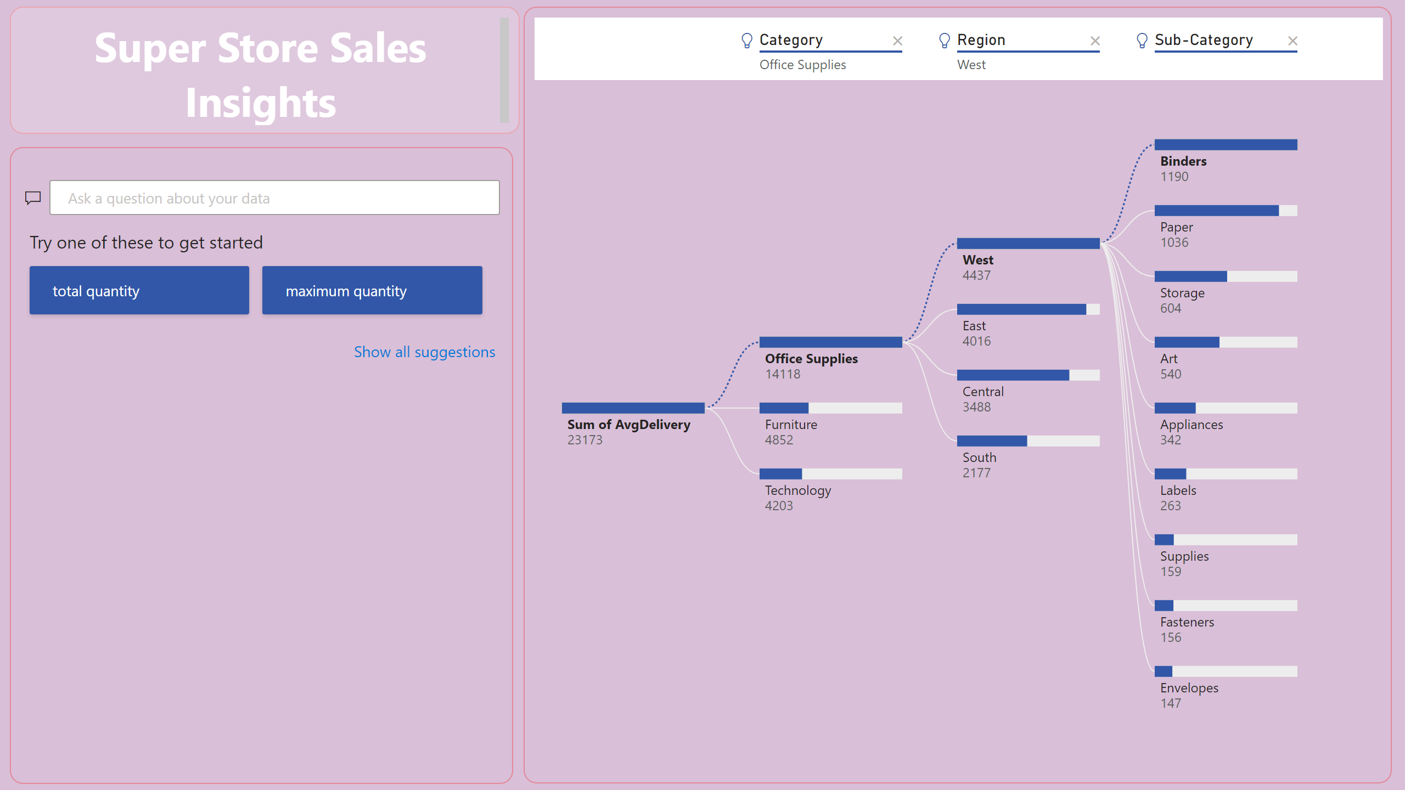
Insights
Notes:
decompositionTreeVisual
No alt text provided
qnaVisual
No alt text provided
textbox
No alt text provided

Slide 5
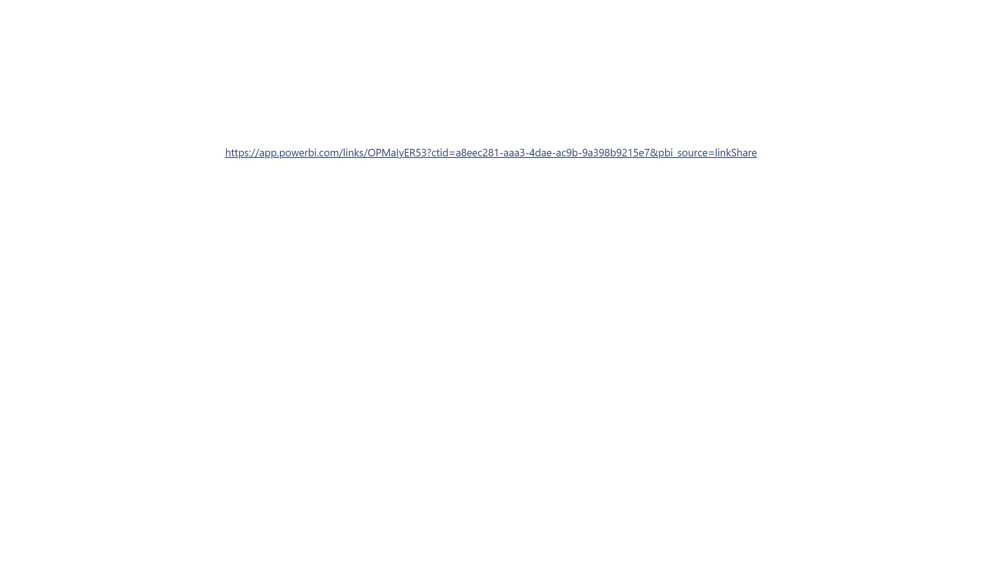
Page 1
Notes:
textbox
No alt text provided

